Slide 1
Project on Career Analysis of “Cristiano Ronaldo”

Slide 2
Objectives
To analyze goal scoring patterns of Cristiano Ronaldo.
To identify performance trends over years.
To discover the strengths & weaknesses of the player.

Slide 3
Dataset
The dataset contains records of International level football matches.
Filtered data focused on ‘Cristiano Ronaldo’.
Total records analyzed : 108

Slide 4
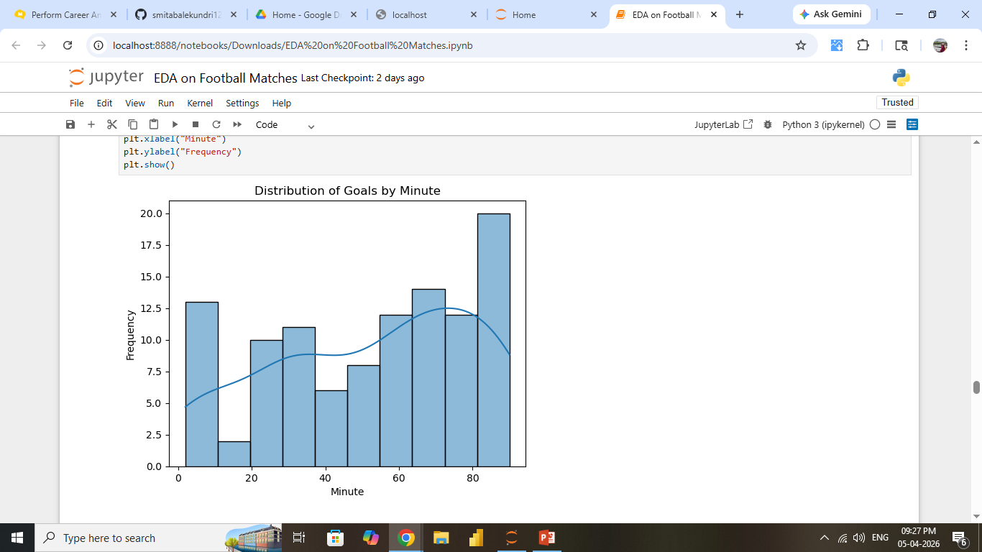
Univariate Analysis Histogram
* Most goals are scored in the second half of the matches.
* There is slight variation in the goal minutes.

Slide 5
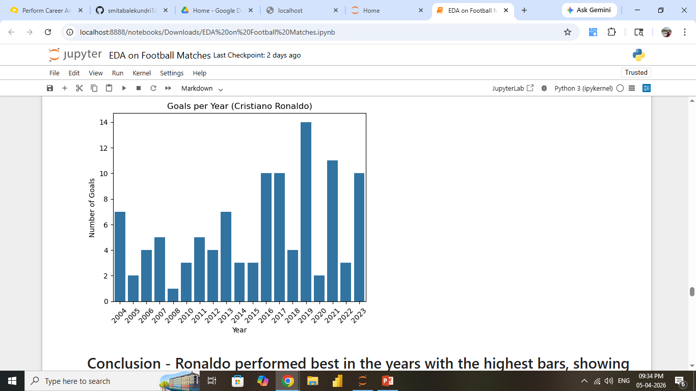
Bivariate Analysis Bar Chart
Certain years show peak performance.
Indicates strong performance in Ronaldo’s career ( 2015, 2016,2019,2021,2023).

Slide 6
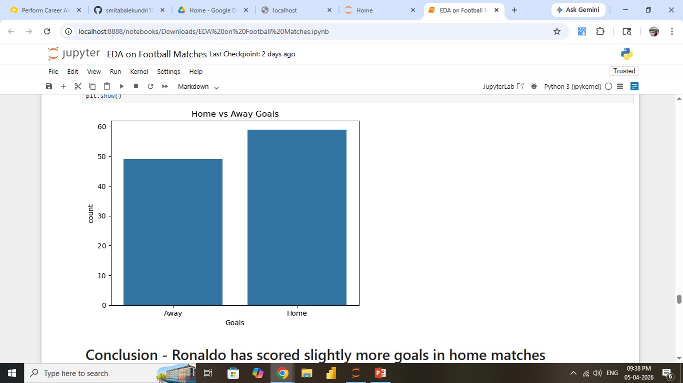
Count Plot
Most goals are scored in Home matches by Ronaldo.

Slide 7
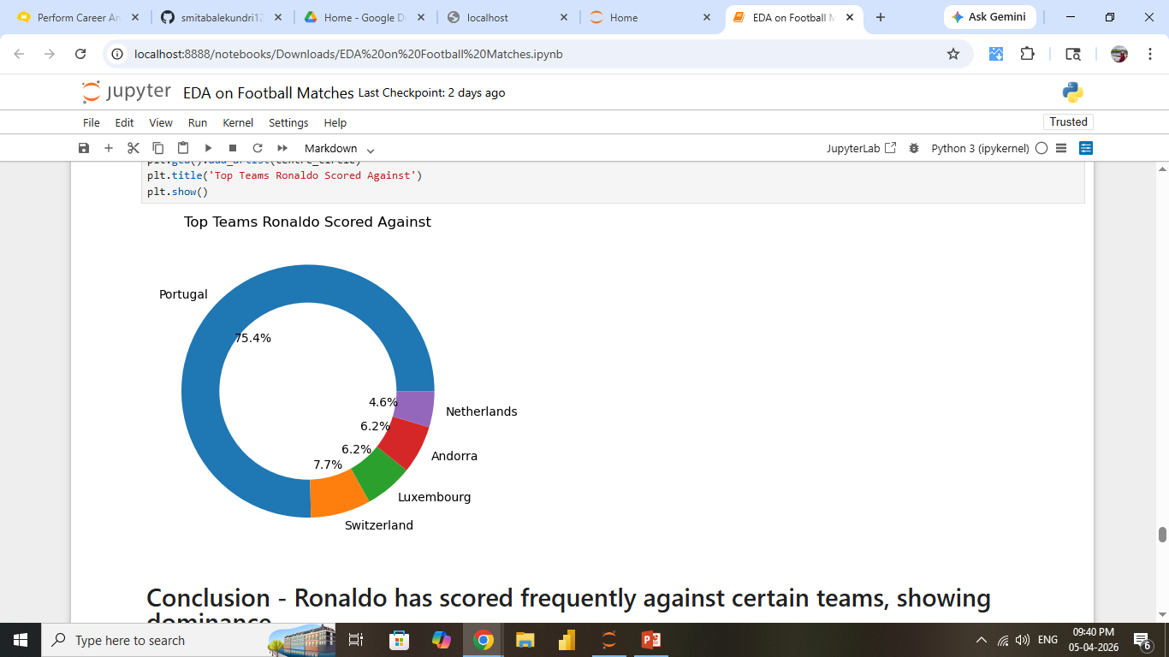
Donut Chart
* Ronaldo has frequently scored against certain teams showing dominance.

Slide 8
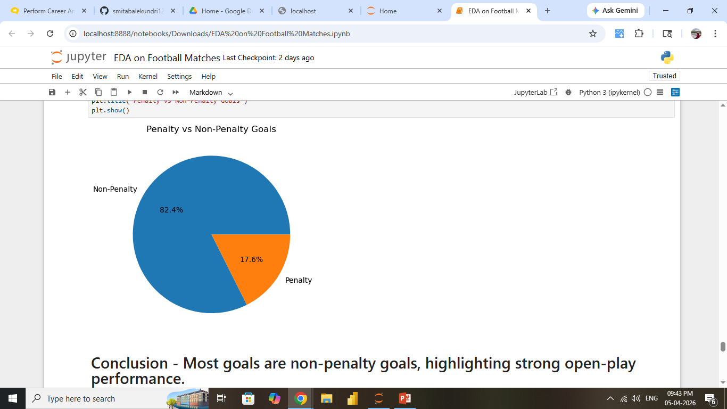
Pie Chart
Majority of goals are non-penalty (82.4%).
Indicates strong scoring ability.

Slide 9
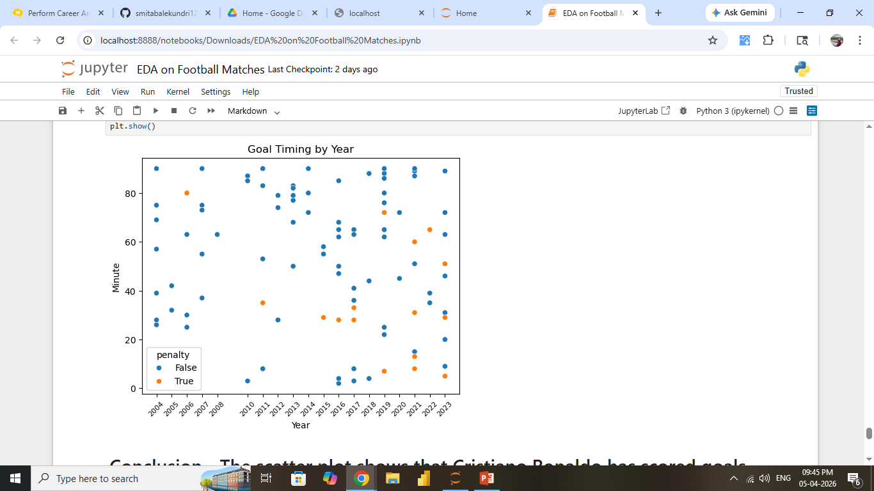
Scatter Plot
Goals are spread across different match minutes.

Slide 10
Best Performance
Highest goal scorings is observed in certain peak years.
Strong performance from the mid to the end of the matches.
High contribution towards non penalty goals.

Slide 11
Weak Performance
Lower goal counts is observed in certain years.
Slight variation in performance across years.

Slide 12
Conclusion
Cristiano Ronaldo shows consistent goal scoring ability across years with clear peak performance periods. His strength is seen during the later stages of matches by maintaining high non penalty goals.

